Slide 1

AMBA AHB
Digital VLSI Design
Actor: Hoang Bao Long

Slide 2
1. Specifications
Digital VLSI Design
Actor: Hoang Bao Long

Slide 3
1. Specifications
1.1. Key features of AMBA AHB protocol
The AHB protocol is a bus architecture designed for high-performance, high-clock frequency system modules. It serves as an efficient system backbone for connecting processors, on-chip memories, and peripherals that require medium to high bandwidth communication.
Key features of AHB include:
Pipelined operations allowing overlapping address and data phases.
Burst transfers for efficient block data movement.
Single-clock edge operation.
Non-tristate implementation.
Configurable data bus widths
Configurable address bus widths

Slide 4
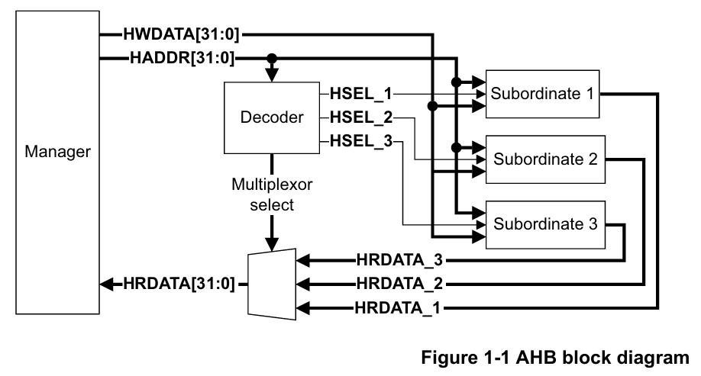
1. Specifications
1.2. Architecture of AMBA AHB
The AHB system consists of masters, slaves, and infrastructure components:
Masters: Initiate read and write operations (processors, DMA controllers)
Slaves: Respond to read/write operations (memories, peripherals)
Decoder: Determines which slave should respond to a transaction
Multiplexor: Routes the selected master's signals to all slaves

Slide 5
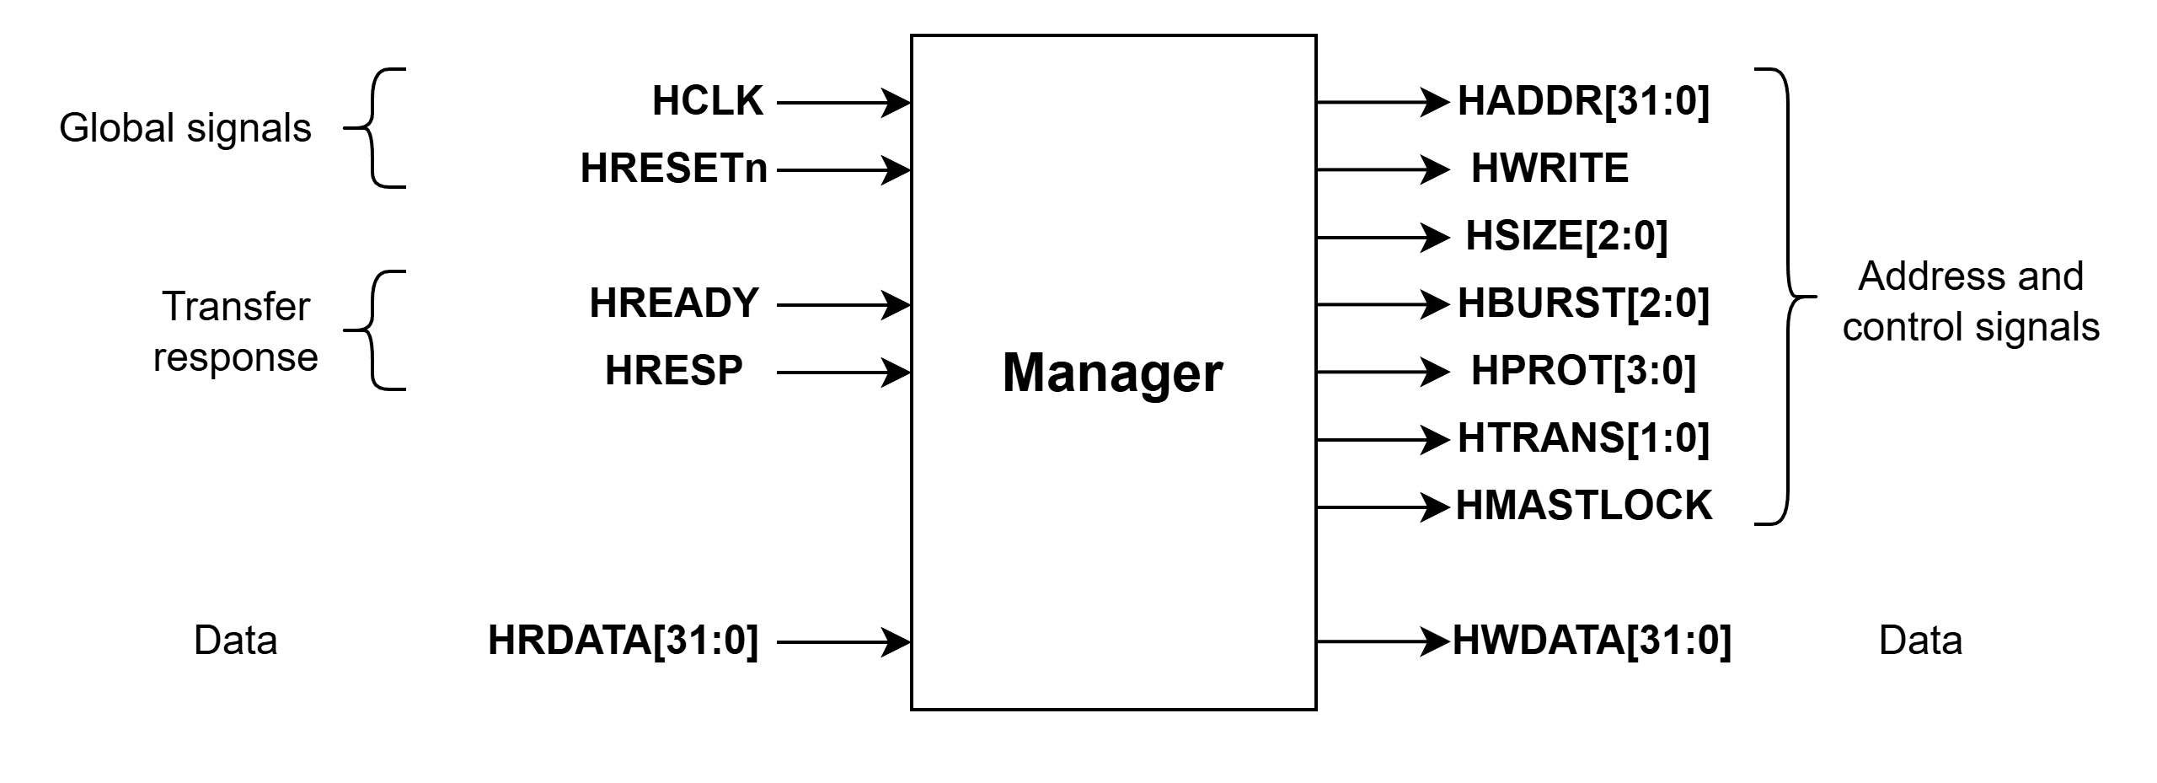
1. Specifications
1.2. Architecture of AMBA AHB
A Manager provides address and control information to initiate read and write operations. Figure below shows a Manager interface.

Slide 6
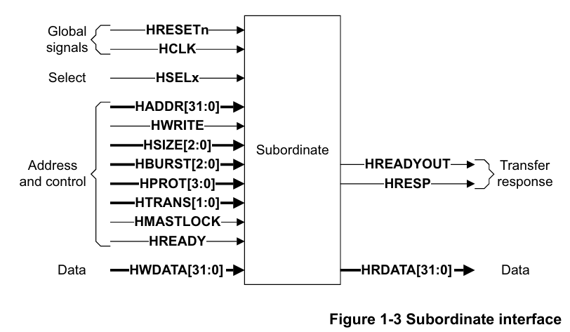
1. Specifications
1.2. Architecture of AMBA AHB
A Subordinate (Slave) responds to transfers initiated by Managers in the system. The Subordinate uses the HSELx select signal from the decoder to control when it responds to a bus transfer.
The Subordinate signals back to the Manager:
The completion or extension of the bus transfer.
The success or failure of the bus transfer.

Slide 7
1. Specifications
1.3. AHB Interface
Signal group | Signal name | Direction | Width (bit) | Descriptions
Global Signals | HCLK | Input | 1 | System clock
 | HRESETn | Input | 1 | Reset signal (active low)
Master Signals | HADDR | Output | 32 | Address bus
 | HWRITE | Output | 1 | Transfer direction (1=write, 0=read)
 | HSIZE | Output | 3 | Transfer size (byte, halfword, word) (1.5.4)
 | HBRUST | Output | 3 | Burst type (1.5.5)
 | HTRANS | Output | 2 | Transfer type (1.5.2)
 | HMASTLOCK | Output | 1 | Locked transfer (1.5.3)
 | HWDATA | Output | 8-1024 | Write data bus (recommend: 32-256 bits)
Slave Signals | HRDATA | Output | 8-1024 | Read data bus (recommend: 32-256 bits)
 | HREADYOUT | Output | 1 | Transfer completion (0: not ready, 1: ready)
 | HRSEP | Output | 2 | Transfer response (0: error, 1: successful)
Decoder Signals | HSELx | Output | 1 | Selects the Subordinate.

Slide 8
1. Specifications
1.4. Transfer operation
1.4.1. Basic Transfers
A transfer consists of two phases:
Address Lasts for a single HCLK cycle unless it is extended by the previous bus transfer.
Data Might require several HCLK cycles. Use the HREADY signal to control the number of clock cycles required to complete the transfer.
HWRITE controls the direction of data transfer to or from the Manager. Therefore, when:
HWRITE is HIGH, it indicates a write transfer and the Manager broadcasts data on the write data bus, HWDATA.
HWRITE is LOW, a read transfer is performed, and the Subordinate must generate the data on the read data bus, HRDATA.

Slide 9
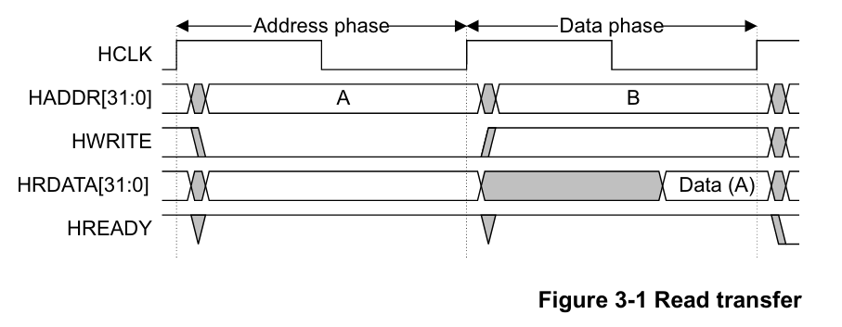
1. Specifications
1.4. Transfer operation
1.4.1. Basic Transfers
Cycle | Key Signals | Descriptions
T0-T1 | HADDR = A, HWRITE = 0, HTRANS = NONSEQ (10), HREADY = 1 | Address phase of Read A. Master places address A on HADDR and indicates a read transfer. Slave begins preparing the data.
T1-T2 | HRDATA = Data(A) valid at end of T2, HADDR = B, HWRITE set for next transfer, HTRANS = SEQ/NONSEQ | Data phase of Read A. Slave returns the read data corresponding to address A. At the same time, master begins the address phase of next transfer B.

Slide 10
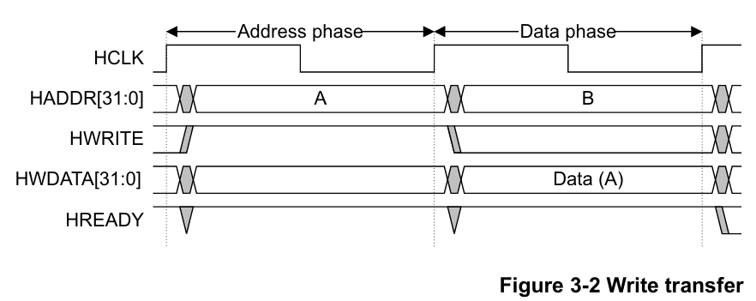
1. Specifications
1.4. Transfer operation
1.4.1. Basic Transfers
Cycle | Key Signals | Descriptions
T0-T1 | HADDR = A, HWRITE = 1, HTRANS = NONSEQ, HREADY = 1 | Address phase of Write A. The master outputs address A and indicates a write transfer. Slave is selected and accepts the transfer setup. The phase completes when HREADY = 1 at T1.
T1-T2 | HWDATA = Data(A), HADDR = B, HWRITE set for B, HTRANS = SEQ/NONSEQ, HREADY = 1 | Data phase of Write A. The master drives valid write data (Data(A)). In parallel, the address phase of the next transfer B begins.

Slide 11
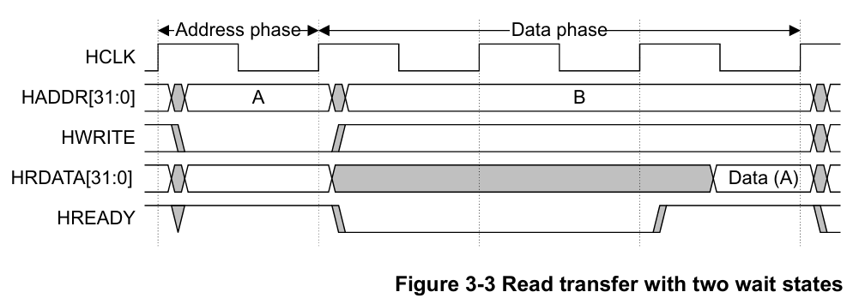
1. Specifications
1.4. Transfer operation
1.4.1. Basic Transfers
Cycle | Key Signals | Descriptions
T0-T1 | HADDR = A, HWRITE = 0, HTRANS = NONSEQ, HREADY = 1 | Address phase of Read A. Master outputs address A and indicates a read. Slave begins preparing data.
T1-T2 | HRDATA invalid, HADDR = B, HREADY = 0 | Start of Data phase for Read A. Slave is not ready, so it inserts a wait state by driving HREADY = 0. Master begins address phase of next transfer B.
T2-T3 | HRDATA invalid, HADDR = B held, HREADY = 0 | Second wait state. Slave still not ready, continues to hold HREADY = 0. Address phase of B must remain stable during the stall.
T3-T4 | HRDATA = Data(A) valid, HREADY = 1 | Completion of Data phase for Read A. Slave finally ready and asserts HREADY = 1. Valid Data(A) is returned at the end of this cycle.

Slide 12
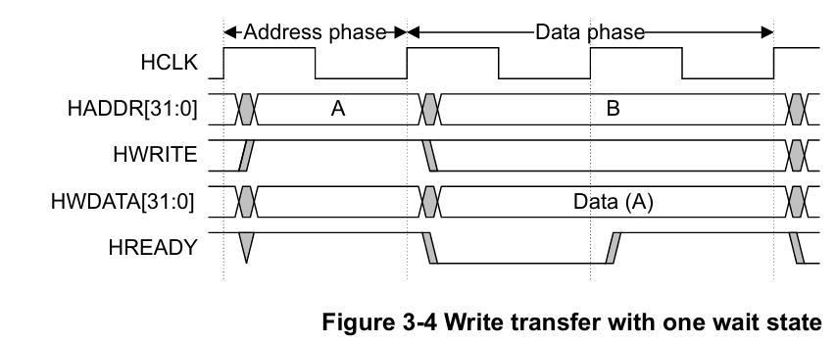
1. Specifications
1.4. Transfer operation
1.4.1. Basic Transfers
Cycle | Key Signals | Descriptions
T0-T1 | HADDR = A, HWRITE = 1, HTRANS = NONSEQ, HREADY = 1 | Address phase of Write A. Master outputs address A and indicates a write transfer. Slave accepts the setup because HREADY = 1.
T1-T2 | HWDATA = Data(A), HADDR = B, HREADY = 0 | Start of Data phase for Write A. Master drives write data (Data(A)). Slave is not ready, so it inserts one wait state by pulling HREADY = 0. Address phase of next transfer B begins in parallel but must be held stable.
T2-T3 | HWDATA sampled, HREADY = 1 | Completion of Data phase for Write A. Slave becomes ready and asserts HREADY = 1, allowing the write to complete.
T3-T4 | HWDATA = Data(B) (if write), HREADY = 1 | Data phase of Write B (if B is a write), or normal continuation of next transfer.

Slide 13
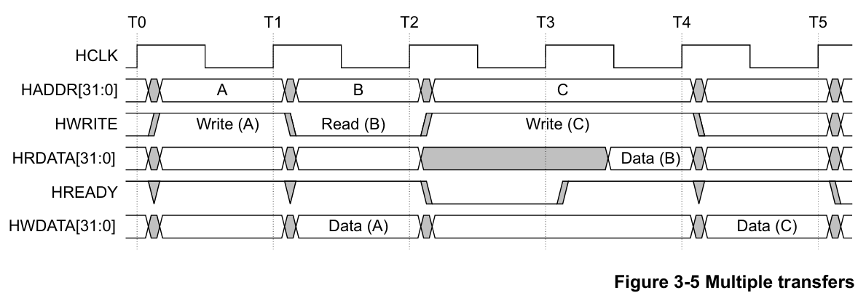
1. Specifications
1.4. Transfer operation
1.4.1. Basic Transfers
Cycle | Key Signals | Descriptions
T0-T1 | HSEL = 1, HTRANS = 10 (NONSEQ), HWRITE = 1, HADDR = Address(A), HREADY = 1 | Address phase of Transfer A. Slave is selected and master issues control signals. Phase completes when HREADY = 1 at T1.
T1-T2 | HWDATA valid, HADDR = Address(B), control signals for B, HREADY = 1 | Data phase of A with valid HWDATA. At the same time, address phase of Transfer B begins. Ends when HREADY = 1 at T2.
T2-T4 | HRDATA valid at T4, HREADY = 0 → 1, HADDR = Address(C) held stable | Data phase of B and address phase of C occur in parallel. Because Read B needs 1 extra cycle, slave drives HREADY = 0 from T2 → T3 to insert a wait state. At T4, slave asserts HREADY = 1 and outputs valid HRDATA. Master must hold address phase of C until HREADY returns to 1.
T4-T5 | HWDATA valid (Write C), HTRANS = 00 if no new transfer | Data phase of C begins, with the address phase of next transfer (if any). If no further transfers, master sets HTRANS = 00 (IDLE).

Slide 14
1. Specifications
1.4. Transfer operation
1.4.2. Transfer types
HTRANS[1:0] | Type | Descriptions
00 | IDLE | No data transfer. Used when the Manager does not intend to perform a transfer. Subordinate must ignore it and return OKAY.
01 | BUSY | Idle cycle inside a burst. Burst continues but the next real transfer cannot occur yet. Subordinate ignores it and returns OKAY.
10 | NONSEQ | Single transfer or first transfer of a burst. Address and control are unrelated to previous cycle.
11 | SEQ | Subsequent transfers in a burst. Address depends on previous transfer and transfer size; may wrap in wrapping bursts.

Slide 15
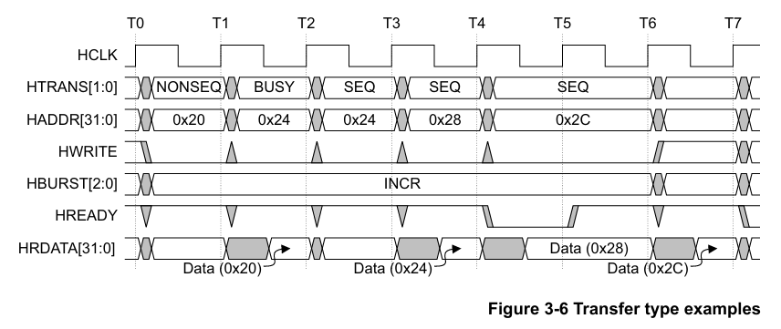
1. Specifications
1.4. Transfer operation
1.4.2. Transfer types
Cycle | Descriptions
T0-T1 | The 4-beat read starts with a NONSEQ transfer.
T1-T2 | The Manager is unable to perform the second beat and inserts a BUSY transfer to delay the start of the second beat. The Subordinate provides the read data for the first beat.
T2-T3 | The Manager is now ready to start the second beat, so a SEQ transfer is signaled. The Manager ignores any data that the Subordinate provides on the read data bus.
T3-T4 | The Manager performs the third beat. The Subordinate provides the read data for the second beat.
T4-T5 | The Manager performs the last beat. The Subordinate is unable to complete the transfer and uses HREADYOUT to insert a single wait state.
T5-T6 | The Subordinate provides the read data for the third beat.
T6-T7 | The Subordinate provides the read data for the last beat.

Slide 16
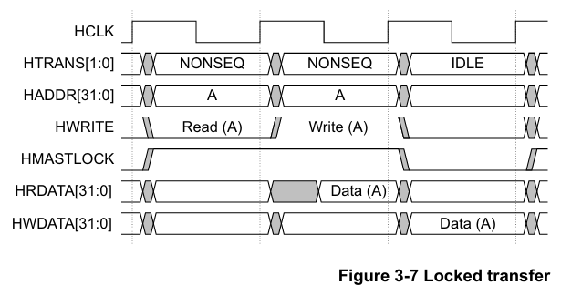
1. Specifications
1.4. Transfer operation
1.4.3. Locked transfers
Note: After a locked transfer, it is recommended that the Manager inserts an IDLE transfer.
Cycle | Key Signals | Descriptions
T0-T1 | HTRANS = NONSEQ, HADDR = A, HWRITE = 0, HMASTLOCK = 1 | Address phase of Read A. Master initiates a NONSEQ read and asserts HMASTLOCK = 1, indicating that the following transfers are part of a locked sequence.
T1-T2 | HRDATA = Data(A), HTRANS = NONSEQ (for write), HWRITE = 1, HADDR = A | Data phase of Read A, with next address phase still A (write). Slave returns Data(A).
T2-T3 | HWDATA = A, HMASTLOCK = 0, HTRANS = IDLE | Data phase of Write A. Master outputs write data for A. End of locked sequence. Master releases lock by de‑asserting HMASTLOCK and issues an IDLE transfer.

Slide 17
1. Specifications
1.4. Transfer operation
1.4.4. Transfer size
HSIZE[2] | HSIZE[1] | HSIZE[0] | Size (Bits) | Descriptions
0 | 0 | 0 | 8 | Byte
0 | 0 | 1 | 16 | Halfword
0 | 1 | 0 | 32 | Word
0 | 1 | 1 | 64 | Doubleword
1 | 0 | 0 | 128 | 4-word line
1 | 0 | 1 | 256 | 8-word line
1 | 1 | 0 | 512 | -
1 | 1 | 1 | 1024 | -
HSIZE[2:0] indicates the size of a data transfer.
Note: The transfer size set by HSIZE must be less than or equal to the width of the data bus. For example, with a 32-bit data bus, HSIZE must only use the values 0b000, 0b001, or 0b010
The HSIZE signals have the same timing as the address bus. However, they must remain constant throughout a burst transfer.
HSIZE in conjunction with HBURST determines the address boundary for wrapping bursts.

Slide 18
1. Specifications
1.5. Burst operation
1.5.1. Burst operation descriptions
HBURST[2:0] | Type | Descriptions
000 | SINGLE | Single transfer burst
001 | INCR | Incrementing burst of undefined length
010 | WRAP4 | 4-beat wrapping burst
011 | INCR4 | 4-beat incrementing burst
100 | WRAP8 | 8-beat wrapping burst
101 | INCR8 | 8-beat incrementing burst
110 | WRAP16 | 16-beat wrapping burst
111 | INCR16 | 16-beat incrementing burst
Managers must not attempt to start an incrementing burst that crosses a 1KB address boundary.
Managers can perform single transfers using either:
SINGLE transfer burst.
Undefined length burst that has a burst of length one.
Note: The burst size indicates the number of beats in the burst and not the number of bytes transferred. Calculate the total amount of data transferred in a burst by multiplying the number of beats by the amount of data in each beat, as indicated by HSIZE[2:0].

Slide 19
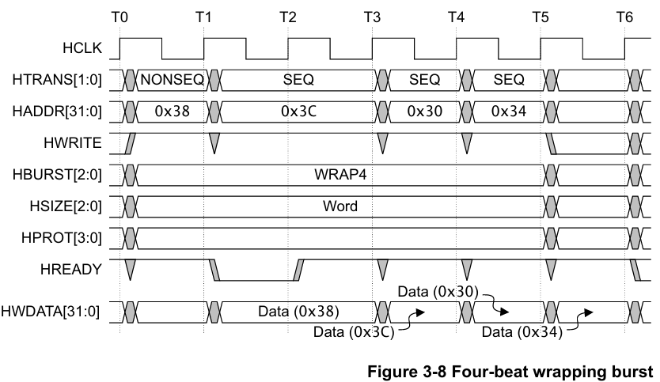
1. Specifications
1.5. Burst operation
1.5.2. Burst example
Cycle | Key Signals | Descriptions
T0-T1 | HTRANS = NONSEQ, HADDR = 0x38, HBURST = WRAP4, HSIZE = Word, HWRITE = 1 | Address phase of Beat 1. Master starts a WRAP4 burst with a NONSEQ transfer. Address = 0x38.
T1-T2 | HWDATA = Data(0x38), HADDR = 0x3C, HTRANS = SEQ | Data phase of Beat 1 (Data for address 0x38). In parallel, address phase of Beat 2 begins: 0x3C.
T2-T3 | HWDATA = Data(0x3C), HADDR = 0x30, HTRANS = SEQ | Data phase of Beat 2 (Data for address 0x3C). Meanwhile, address phase of Beat 3 occurs. Because it is WRAP4, the address wraps: 0x30.
T3-T4 | HWDATA = Data(0x30), HADDR = 0x34, HTRANS = SEQ | Data phase of Beat 3 (Data for address 0x30). At the same time, address phase of Beat 4 occurs: 0x34.
T4-T5 | HWDATA = Data(0x34), HREADY = 1 | Data phase of Beat 4 (Data for address 0x34). Burst transfer is still active.
T5-T6 | HTRANS = IDLE | Burst completes. Master transitions to IDLE or starts a new burst depending on next command.

Slide 20
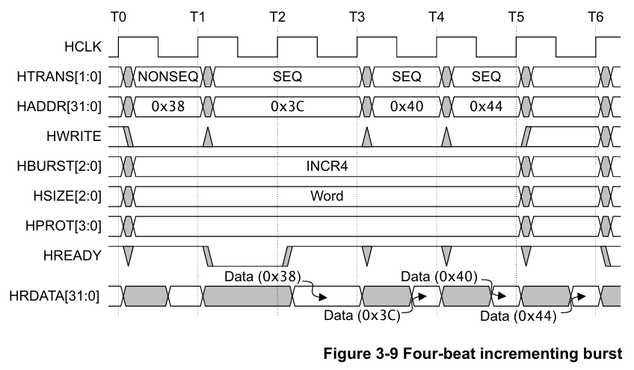
1. Specifications
1.5. Burst operation
1.5.2. Burst example
Cycle | Key Signals | Descriptions
T0-T1 | HTRANS = NONSEQ, HADDR = 0x38, HBURST = INCR4, HSIZE = Word | Address phase of Beat 1. Master starts an INCR4 burst with a NONSEQ transfer, issuing address 0x38.
T1-T2 | HRDATA = Data(0x38), HADDR = 0x3C, HTRANS = SEQ | Data phase of Beat 1 (Data for 0x38). In parallel, the master issues address of Beat 2: 0x3C (increment by 4).
T2-T3 | HRDATA = Data(0x3C), HADDR = 0x40, HTRANS = SEQ | Data phase of Beat 2 (Data for 0x3C). Meanwhile, address phase of Beat 3: 0x40.
T3-T4 | HRDATA = Data(0x40), HADDR = 0x44, HTRANS = SEQ | Data phase of Beat 3 (Data for 0x40). Master issues address phase of Beat 4: 0x44.
T4-T5 | HRDATA = Data(0x44), HREADY = 1 | Data phase of Beat 4 (Data for 0x44). Burst still ongoing.
T5-T6 | HTRANS = IDLE, HBURST no longer active | Burst completes. Master transitions to IDLE or starts the next transfer.

Slide 21
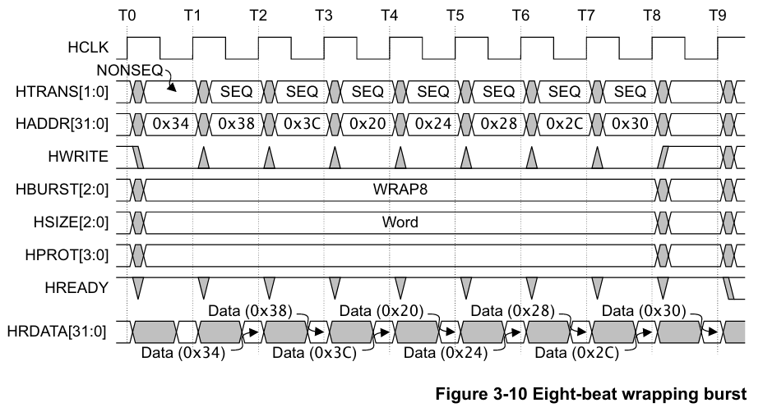
1. Specifications
1.5. Burst operation
1.5.2. Burst example
Cycle | Key Signals | Descriptions
T0-T1 | HTRANS = NONSEQ, HADDR = 0x34, HBURST = WRAP8, HSIZE = Word | Address phase of Beat 1. Master begins the WRAP8 burst with a NONSEQ transfer at address 0x34.
T1-T2 | HRDATA = Data(0x34), HADDR = 0x38, HTRANS = SEQ | Data phase of Beat 1 (Data for address 0x34). Master issues address of Beat 2: 0x38.
T2-T3 | HRDATA = Data(0x38), HADDR = 0x3C, HTRANS = SEQ | Data phase of Beat 2 (0x38). Master issues address of Beat 3: 0x3C.
T3-T4 | HRDATA = Data(0x3C), HADDR = 0x20, HTRANS = SEQ | Data phase of Beat 3 (0x3C). Master issues address of Beat 4: 0x20. (Address wraps to start of 32‑byte boundary.)
T4-T5 | HRDATA = Data(0x20), HADDR = 0x24, HTRANS = SEQ | Data phase of Beat 4 (0x20). Master issues address of Beat 5: 0x24.

Slide 22
1. Specifications
1.5. Burst operation
1.5.2. Burst example
Cycle | Key Signals | Descriptions
T5-T6 | HRDATA = Data(0x24), HADDR = 0x28, HTRANS = SEQ | Data phase of Beat 5 (0x24). Master issues address of Beat 6: 0x28.
T6-T7 | HRDATA = Data(0x28), HADDR = 0x2C, HTRANS = SEQ | Data phase of Beat 6 (0x28). Master issues address of Beat 7: 0x2C.
T7-T8 | HRDATA = Data(0x2C), HADDR = 0x30, HTRANS = SEQ | Data phase of Beat 7 (0x2C). Master issues address of Beat 8: 0x30.
T8-T9 | HRDATA = Data(0x30), HTRANS = IDLE | Data phase of Beat 8 (0x30). Burst ends. Master may go IDLE or start a new transfer.

Slide 23
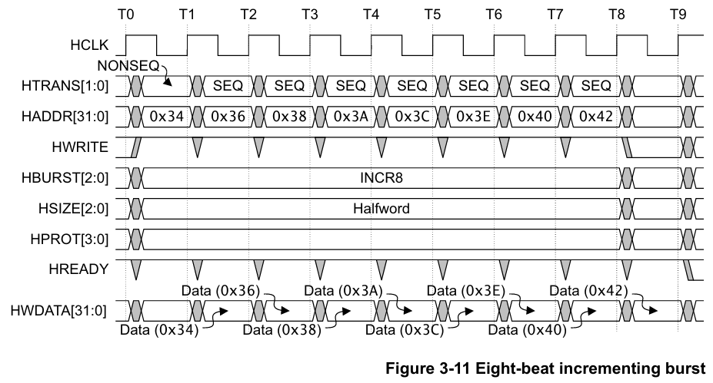
1. Specifications
1.5. Burst operation
1.5.2. Burst example
Cycle | Key Signals | Descriptions
T0-T1 | HTRANS = NONSEQ, HADDR = 0x34, HBURST = INCR8, HSIZE = Halfword | Address phase of Beat 1. Master begins the INCR8 burst with a NONSEQ transfer at address 0x34.
T1-T2 | HWDATA = Data(0x34), HADDR = 0x36, HTRANS = SEQ | Data phase of Beat 1 (Data for 0x34). Master issues address of Beat 2: 0x36 (increment by 2 bytes because Halfword).
T2-T3 | HWDATA = Data(0x36), HADDR = 0x38, HTRANS = SEQ | Data phase of Beat 2 (Data for 0x36). Master issues address of Beat 3: 0x38.
T3-T4 | HWDATA = Data(0x38), HADDR = 0x3A, HTRANS = SEQ | Data phase of Beat 3 (Data for 0x38). Master issues address of Beat 4: 0x3A.
T4-T5 | HWDATA = Data(0x3A), HADDR = 0x3C, HTRANS = SEQ | Data phase of Beat 4 (Data for 0x3A). Master issues address of Beat 5: 0x3C.

Slide 24
1. Specifications
1.5. Burst operation
1.5.2. Burst example
Cycle | Key Signals | Descriptions
T5-T6 | HWDATA = Data(0x3C), HADDR = 0x3E, HTRANS = SEQ | Data phase of Beat 5 (0x3C). Master issues address of Beat 6: 0x3E.
T6-T7 | HWDATA = Data(0x3E), HADDR = 0x40, HTRANS = SEQ | Data phase of Beat 6 (0x3E). Master issues address of Beat 7: 0x40.
T7-T8 | HWDATA = Data(0x40), HADDR = 0x42, HTRANS = SEQ | Data phase of Beat 7 (0x40). Master issues address of Beat 8: 0x42.
T8-T9 | HWDATA = Data(0x42), HTRANS = IDLE | Data phase of Beat 8 (0x42). Burst completes; master may go IDLE or start new transfer.

Slide 25
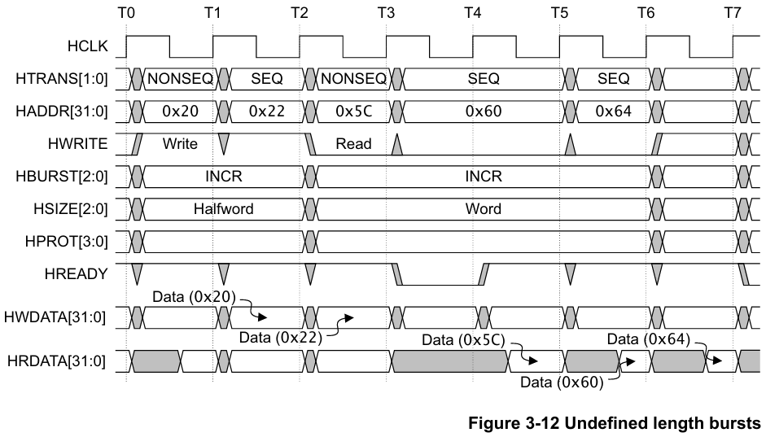
1. Specifications
1.5. Burst operation
1.5.2. Burst example
Cycle | Key Signals | Descriptions
T0-T1 | HTRANS = NONSEQ, HADDR = 0x20, HWRITE = 1, HBURST = INCR, HSIZE = Halfword | Address phase of first write transfer. Master issues NONSEQ write at address 0x20, starting an undefined‑length INCR burst (HBURST = INCR).
T1-T2 | HWDATA = Data(0x20), HADDR = 0x22, HTRANS = SEQ | Data phase of write @0x20. Master drives Data(0x20). At the same time, address phase of next beat @0x22 begins.
T2-T3 | HTRANS = NONSEQ, HADDR = 0x5C, HWRITE = 0, HBURST = INCR (new burst) | Address phase of a new NONSEQ transfer (read). Because the burst is undefined length, the master is free to start a new NONSEQ. Address = 0x5C.
T3-T4 | HRDATA = Data(0x5C), HADDR = 0x60, HTRANS = SEQ | Data phase of read @0x5C. Slave returns Data(0x5C). Master issues address phase of next beat: 0x60.
T4-T5 | HRDATA = Data(0x60), HADDR = 0x64, HTRANS = SEQ | Data phase of beat @0x60. Master issues address phase of next beat: 0x64.

Slide 26
1. Specifications
1.5. Burst operation
1.5.2. Burst example
Cycle | Key Signals | Descriptions
T5-T6 | HRDATA = Data(0x64), HREADY = 1 | Data phase of beat @0x64. Next SEQ transfer still valid.
T6-T7 | HTRANS depends on next transfer | Burst may continue as INCR (undefined length) or master may terminate by issuing IDLE/BUSY/NONSEQ.

Slide 27
1. Specifications
1.6. Waited transfers
Subordinates use HREADY to insert wait states if they require more time to provide or sample the data.
During a waited transfer, the Manager is restricted to what changes it can make to the transfer type and address.
These restrictions are described in the following sections:
Transfer type changes during wait states
Address changes during wait states

Slide 28
1. Specifications
1.6. Waited transfers
1.6.1. Transfer type changes during wait states
When the Subordinate is requesting wait states, the Manager must not change the transfer type, except as described
in:
IDLE transfer
BUSY transfer, fixed-length burst
BUSY transfer, undefined length burst

Slide 29
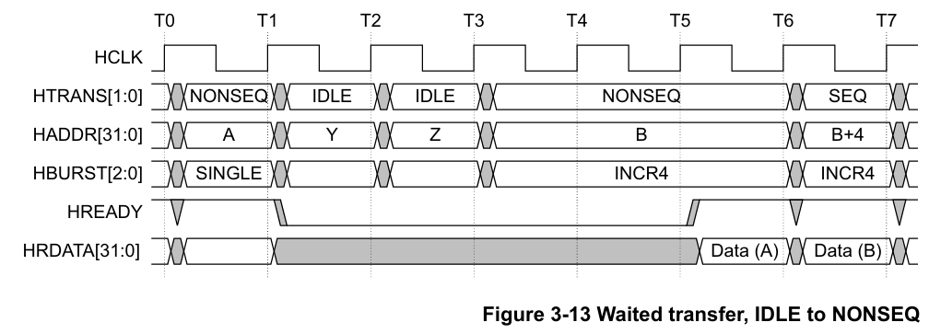
1. Specifications
1.6. Waited transfers
1.6.1. Transfer type changes during wait states
Cycle | Descriptions
T0-T1 | The Manager initiates a SINGLE burst to address A.
T1-T2 | The Manager inserts one IDLE transfer to address Y. The Subordinate inserts a wait state with HREADY= LOW.
T2-T3 | The Manager inserts one IDLE transfer to address Z.
T3-T4 | The Manager changes the transfer type to NONSEQ and initiates an INCR4 transfer to address B.
T4-T5 | With HREADY LOW, the Manager must keep HTRANS constant.
T5-T6 | SINGLE burst to address A completes with HREADY HIGH and the Manager starts the first beat to address B.
T6-T7 | First beat of the INCR4 transfer to address B completes and the Manager starts the next beat to address B+4.
During a waited transfer, the Manager is permitted to change the transfer type from IDLE to NONSEQ. When the HTRANS transfer type changes to NONSEQ the Manager must keep HTRANS constant, until HREADY is HIGH.

Slide 30
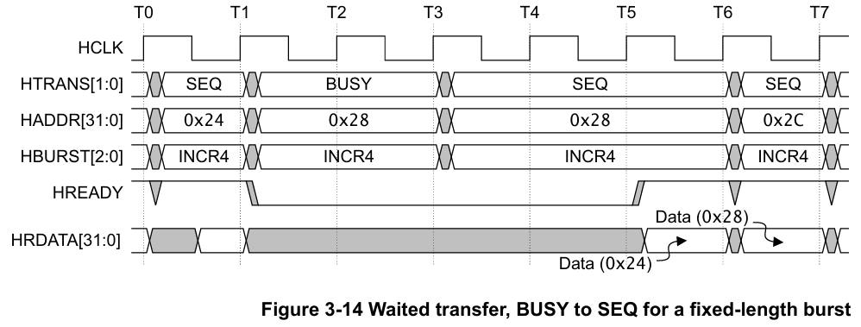
1. Specifications
1.6. Waited transfers
1.6.1. Transfer type changes during wait states
Cycle | Descriptions
T0-T1 | The Manager initiates the next beat of the INCR4 burst to address 0x24.
T1-T3 | The Manager inserts a BUSY transfer to address 0x28. The Subordinate inserts wait states with HREADY = LOW.
T3-T4 | The Manager changes the transfer type to SEQ and initiates the next beat of the burst to address 0x28.
T4-T5 | With HREADY LOW, the Manager must keep HTRANS constant.
T5-T6 | Beat to address 0x24 completes with HREADY HIGH.
T6-T7 | Third beat of the INCR4 transfer to address 0x28 completes and the Manager starts the final beat to address 0x2C.
Note: Because BUSY transfers must only be inserted between successive beats of a burst, this does not apply to SINGLE bursts. Therefore this situation applies to the following burst types:
INCR4, INCR8, and INCR16.
WRAP4, WRAP8, and WRAP16.

Slide 31
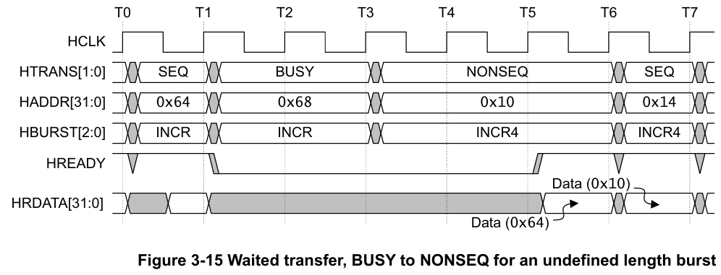
1. Specifications
1.6. Waited transfers
1.6.1. Transfer type changes during wait states
Cycle | Descriptions
T0-T1 | The Manager initiates the next beat of the INCR burst to address 0x64.
T1-T3 | The Manager inserts a BUSY transfer to address 0x68. The Subordinate inserts wait states with HREADY = LOW.
T3-T4 | The Manager changes the transfer type to NONSEQ and initiates a new burst to address 0x10.
T4-T5 | With HREADY LOW, the Manager must keep HTRANS constant.
T5-T6 | Undefined length burst completes with HREADY HIGH and the Manager starts the first beat to address 0x10.
T6-T7 | First beat of the INCR4 transfer to address 0x10 completes and the Manager starts the next beat to address 0x14.
During a waited transfer for an undefined length burst, INCR, the Manager is permitted to change from BUSY to any other transfer type, when HREADY is LOW. The burst continues if a SEQ transfer is performed but terminates if an IDLE or NONSEQ transfer is performed.

Slide 32
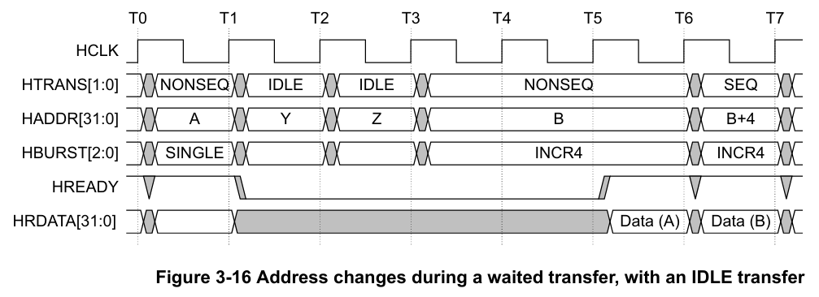
1. Specifications
1.6. Waited transfers
1.6.2. Address changes during wait states
Cycle | Descriptions
T0-T1 | The Manager initiates a SINGLE burst to address A.
T1-T2 | The Manager inserts one IDLE transfer to address Y. The Subordinate inserts a wait state with HREADY = LOW.
T2-T3 | The Manager inserts one IDLE transfer to address Z.
T3-T5 | The Manager changes the transfer type to NONSEQ and initiates an INCR4 transfer to address B. Until HREADY goes HIGH, no more address changes are permitted.
T5-T6 | SINGLE burst to address A completes with HREADY HIGH and the Manager starts the first beat to address B.
T6-T7 | First beat of the INCR4 transfer to address B completes and the Manager starts the next beat to address B+4.
During a waited transfer, the Manager is permitted to change the address for IDLE transfers. When the HTRANS transfer type changes to NONSEQ, the Manager must keep the address constant until HREADY is HIGH.

Slide 33
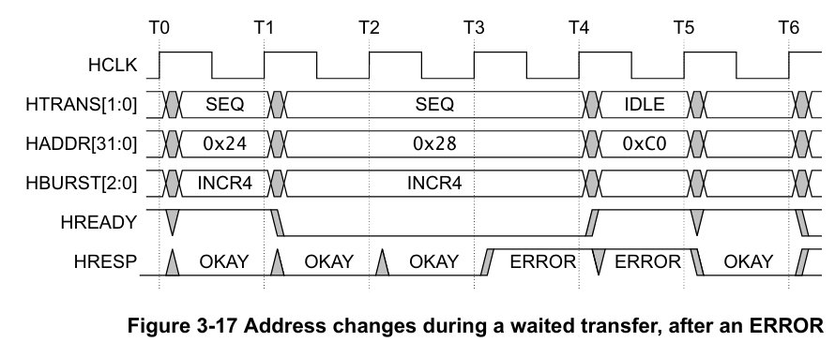
1. Specifications
1.6. Waited transfers
1.6.2. Address changes during wait states
Cycle | Descriptions
T0-T1 | The Manager initiates the next beat of the burst to address 0x24.
T1-T3 | The Manager initiates the next beat of the burst to address 0x28. The Subordinate responds with OKAY.
T3-T4 | The Subordinate responds with ERROR.
T4-T5 | The Manager changes the transfer type to IDLE and is permitted to change the address while HREADY is LOW. The Subordinate completes the ERROR response.
T5-T6 | The Subordinate at address 0xC0 responds with OKAY.
During a waited transfer, if the Subordinate responds with an ERROR response, then the Manager is permitted to change the address when HREADY is LOW.

Slide 34
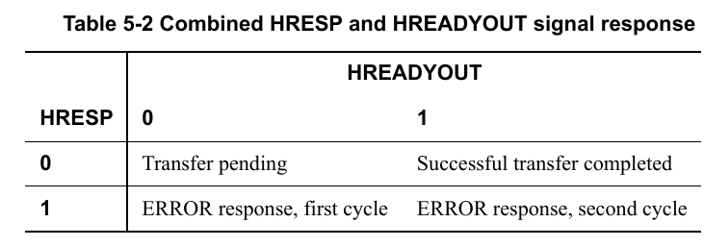
1. Specifications
1.8. Subordinate Response Signaling
After a Manager has started a transfer, the Subordinate controls how the transfer progresses. A Manager cannot cancel a transfer after it has commenced.
A Subordinate must provide a response that indicates the status of the transfer when it is accessed. The transfer status is provided by the HRESP signal.
HRESP | Response | Descriptions
0 | OKAY | The transfer has either completed successfully or additional cycles are required for the Subordinate to complete the request. The HREADY signal indicates whether the transfer is pending or complete.
1 | ERROR | An error has occurred during the transfer. The error condition must be signaled to the Manager so that it is aware the transfer has been unsuccessful. A two-cycle response is required for an error condition with HREADY being asserted in the second cycle.

Slide 35
1. Specifications
1.8. Subordinate Response Signaling
1.8.1. Transfer done
A successful completed transfer is signaled when HREADY is HIGH and HRESP is OKAY.

Slide 36
1. Specifications
1.8. Subordinate Response Signaling
1.8.2. Transfer pending
A typical Subordinate uses HREADY to insert the appropriate number of wait states into the data phase of the transfer. The transfer then completes with HREADY HIGH and an OKAY response to indicate the successful completion of the transfer.
When a Subordinate inserts a number of wait states prior to completing the response, it must drive HRESP to OKAY.
Note: In general, every Subordinate must have a predetermined maximum number of wait states that it inserts before it completes a transfer. This enables the maximum latency for accessing the bus to be calculated. Inserting wait states stalls the entire AHB interface, so long periods of wait states can have a negative impact on the system performance.

Slide 37
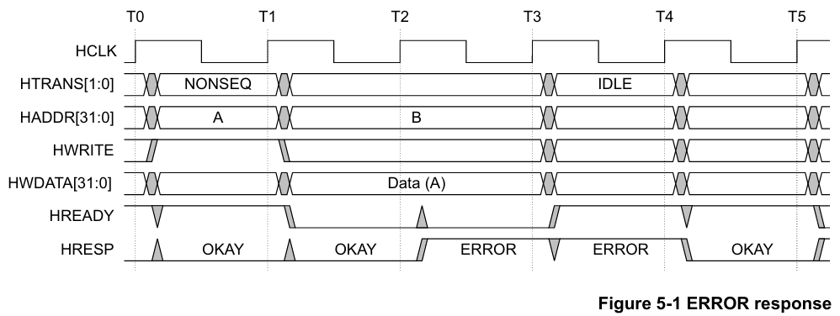
1. Specifications
1.8. Subordinate Response Signaling
1.8.3. ERROR response
Cycle | Descriptions
T1-T2 | The Subordinate inserts a wait state and provides an OKAY response.
T2-T3 | The Subordinate issues an ERROR response. This is the first cycle of the ERROR response because HREADY is LOW.
T3-T4 | The Subordinate issues an ERROR response. This is the last cycle of the ERROR response because HREADY is now HIGH. The Manager changes the transfer type to IDLE. This cancels the intended transaction to address B, that was registered by a Subordinate at time T2.
T4-T5 | Subordinate responds with an OKAY response.

Slide 38
2. Verification Plans
Digital VLSI Design
Actor: Hoang Bao Long

Slide 39
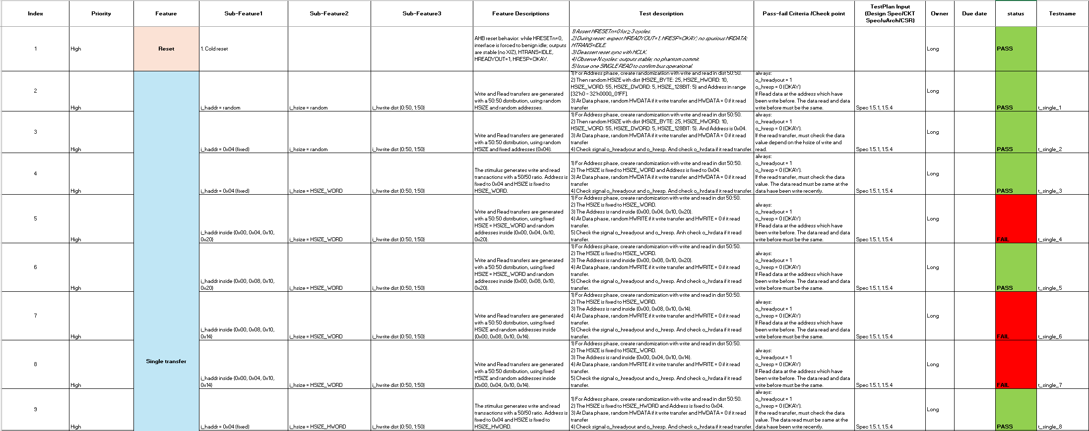
2. Verification Plans

Slide 40
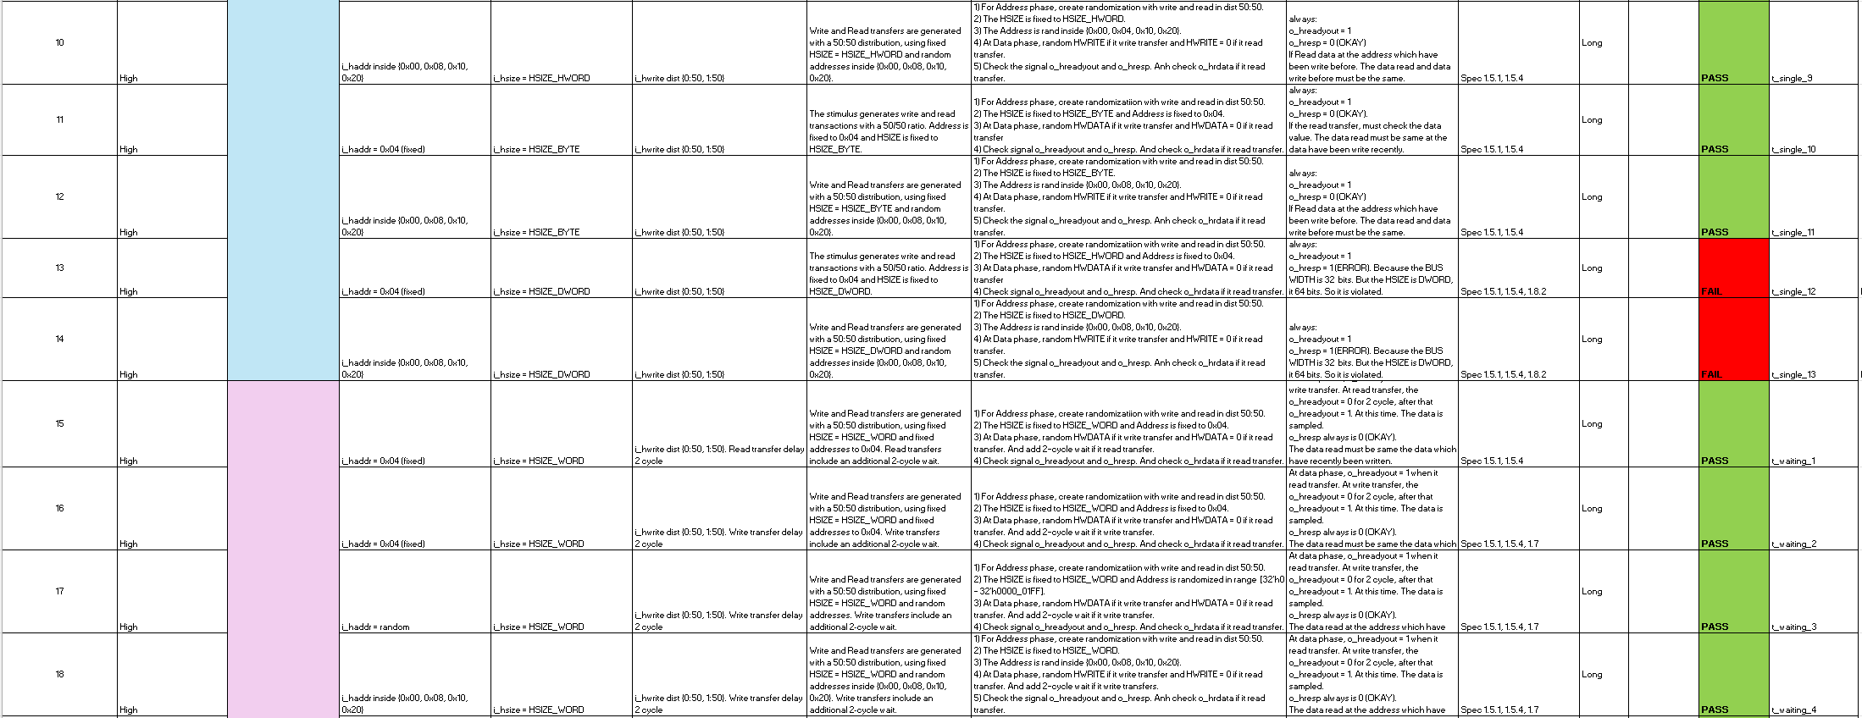
2. Verification Plans

Slide 41
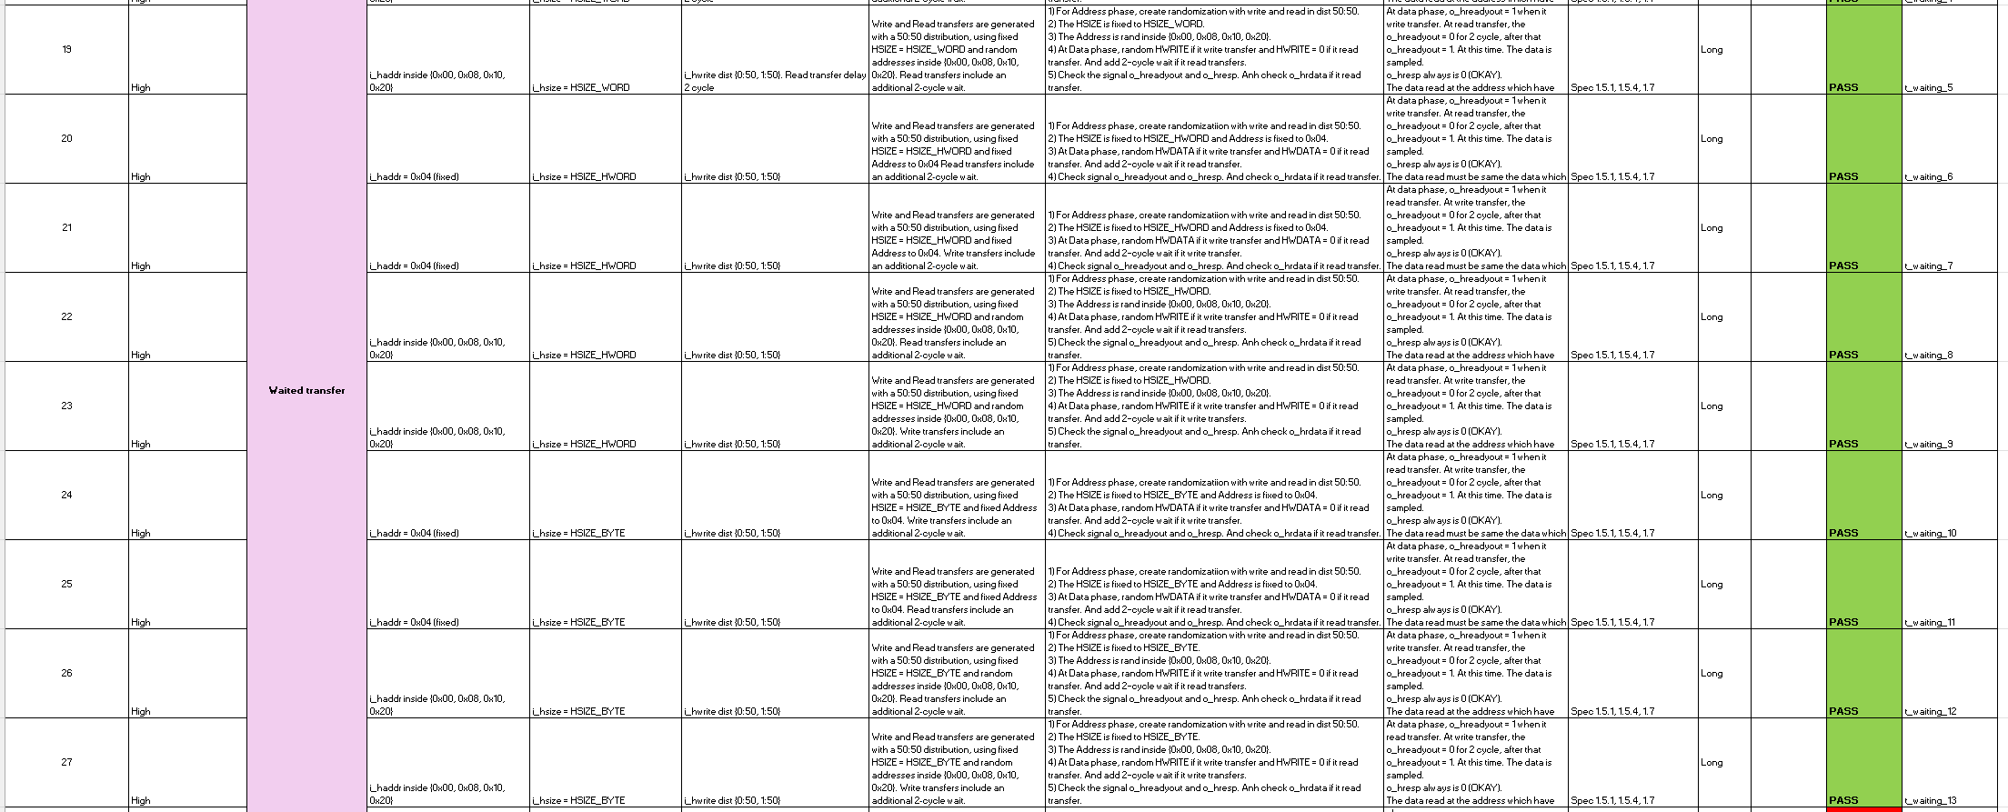
2. Verification Plans

Slide 42
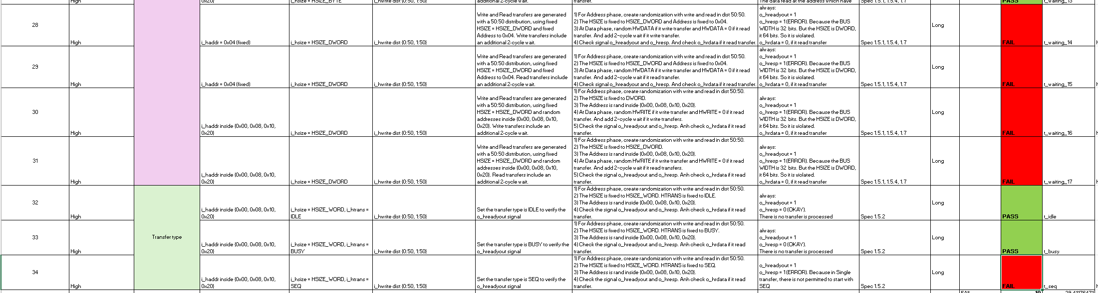
2. Verification Plans

Slide 43
2. Verification Plans
No. | Assertion | Purpose | Expected behavior
1 | VALID_RESP | Check response signals validity | HREADYOUT and HRESP must not be X/Z during a valid transfer
2 | OKAY_COMPLETE | Functional coverage | Detect a successful transaction completion (OKAY + READY)
3 | ERROR_2CYCLE | Check AHB error protocol | ERROR response must occur in 2 cycles: (ERROR,READY=0) → (ERROR,READY=1)
4 | NO_SINGLE_ERROR | Prevent protocol violation | Single-cycle ERROR response is not allowed
5 | HSIZE3_ERROR | Illegal transfer size check | HSIZE = 3 must generate ERROR response
6 | HTRANS_SEQ_ERROR | Unsupported single transfer type check | HTRANS = SEQ must generate ERROR response

Slide 44
3. Environment
Digital VLSI Design
Actor: Hoang Bao Long

Slide 45
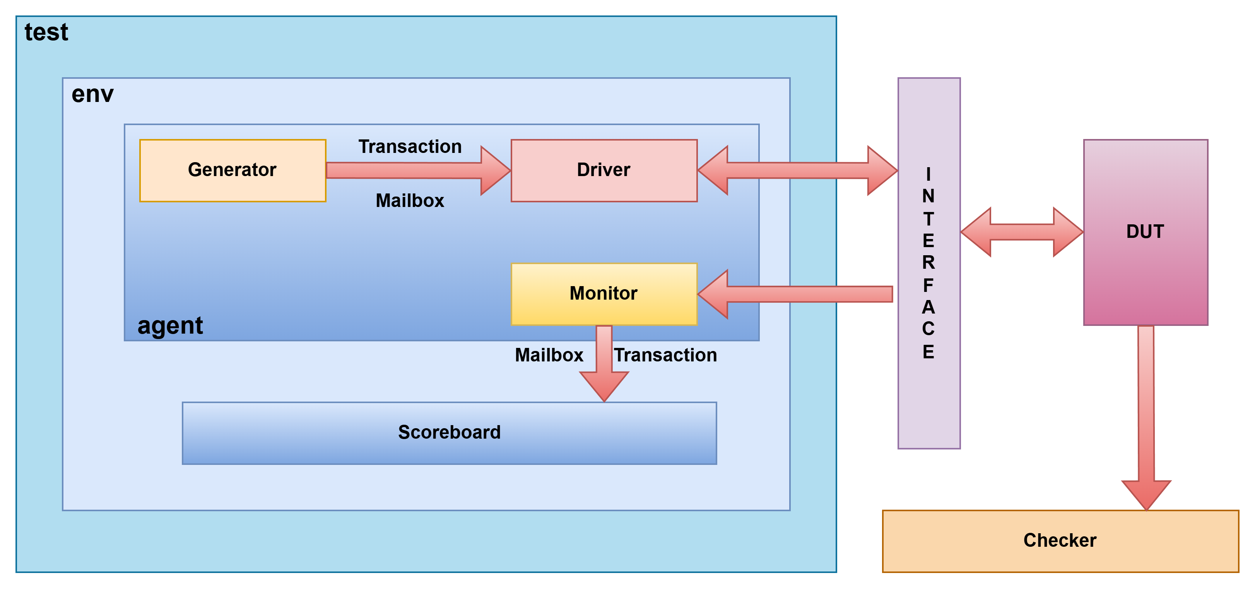
3. Environment
3.1. Testbench Architecture

Slide 46
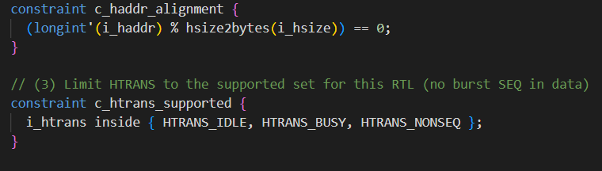
3. Environment
3.2. Randomization Constraints

Slide 47
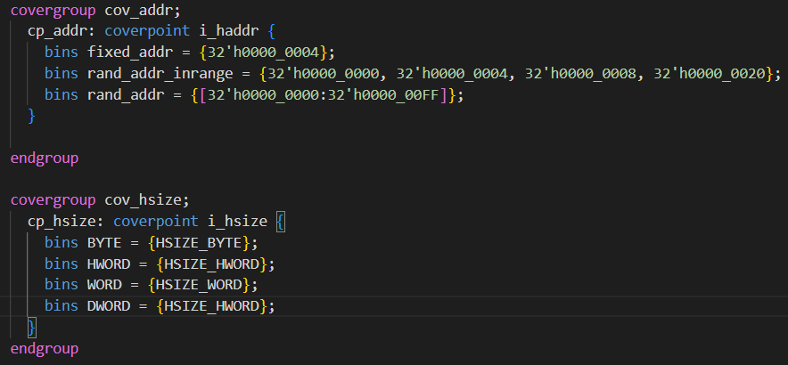
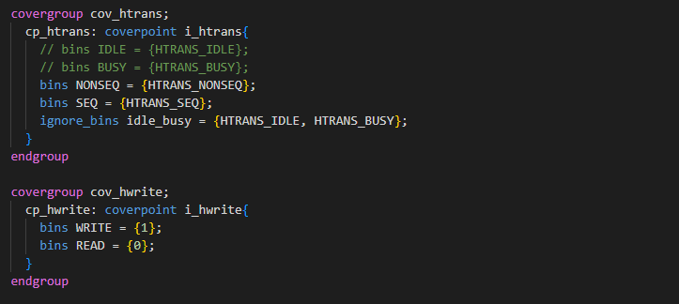
3. Environment
3.3. Function Coverage

Slide 48
4. Verification results
Digital VLSI Design
Actor: Hoang Bao Long

Slide 49
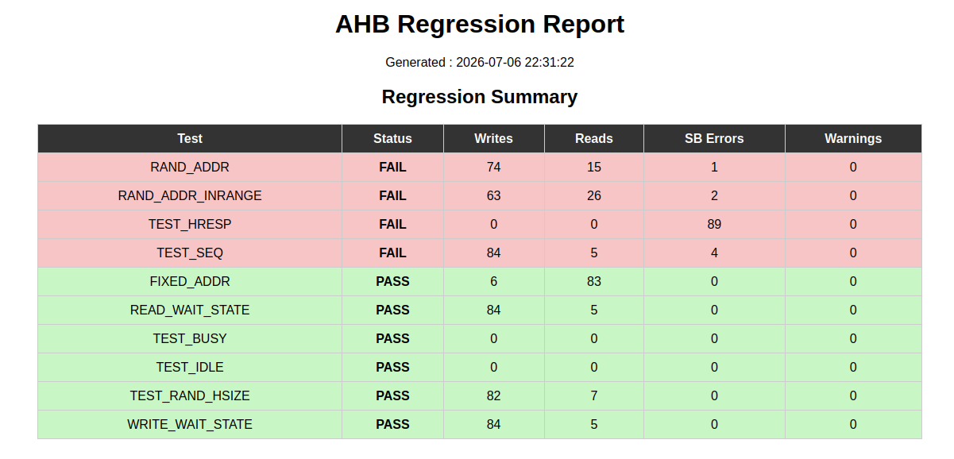
4. Verification results

Slide 50
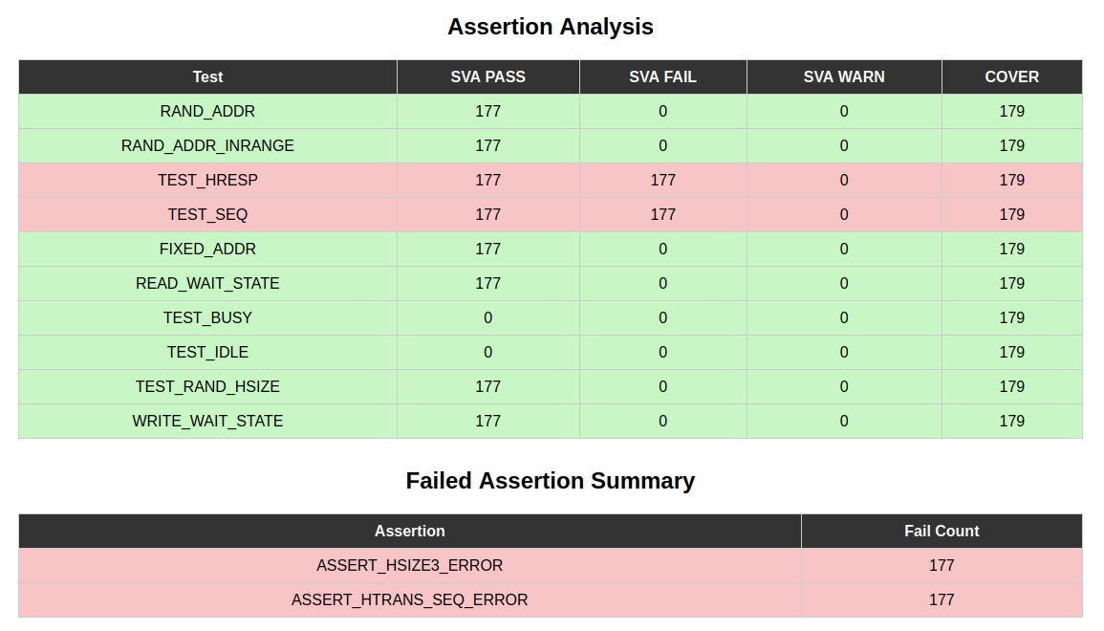
4. Verification results

Slide 51
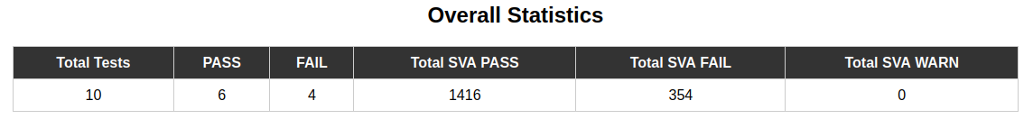
4. Verification results

Slide 52
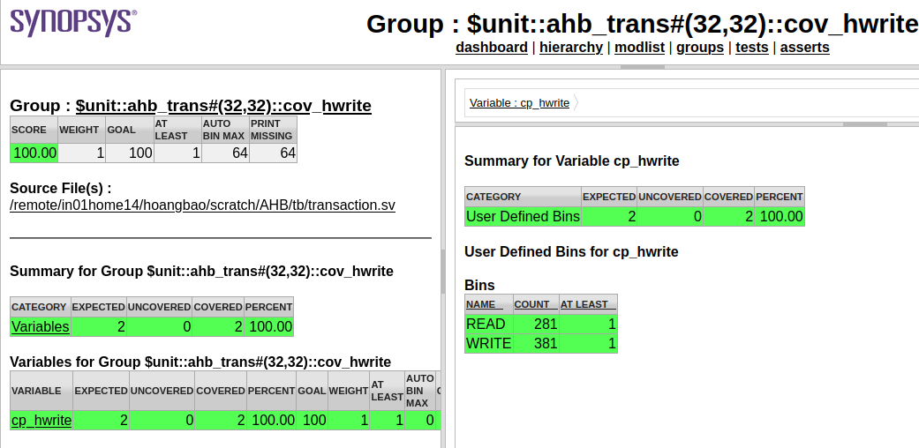
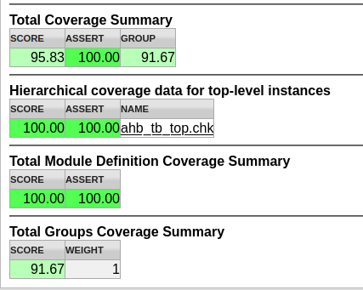
4. Verification results

Slide 53
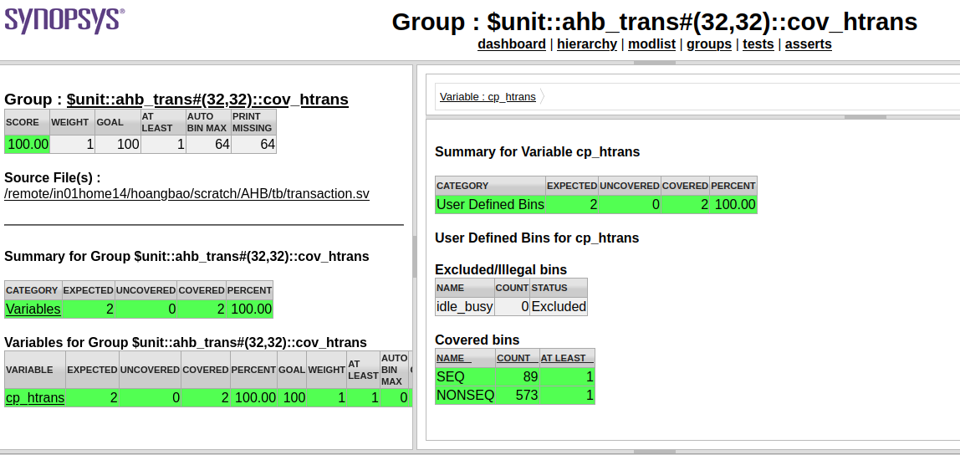
4. Verification results

Slide 54
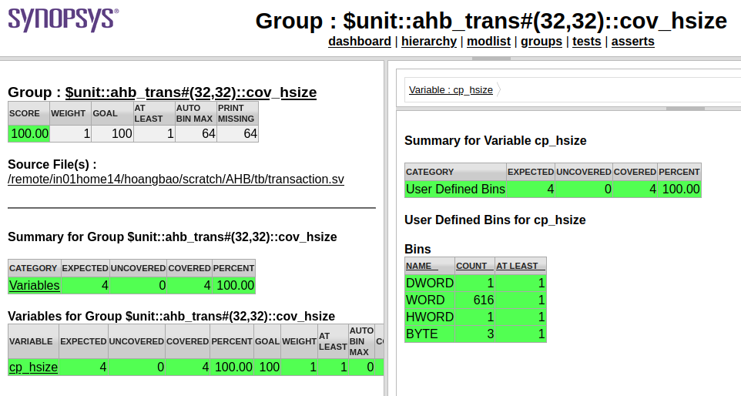
4. Verification results

Slide 55
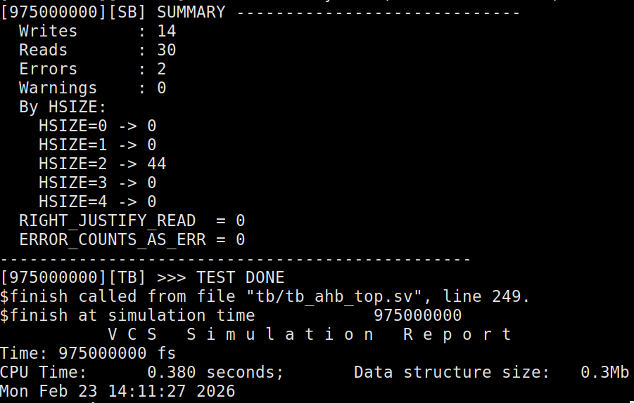
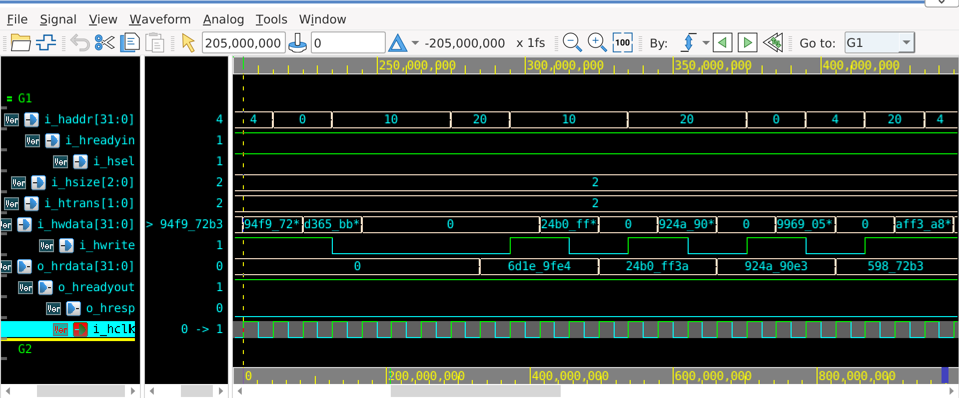
4. Verification results

Slide 56
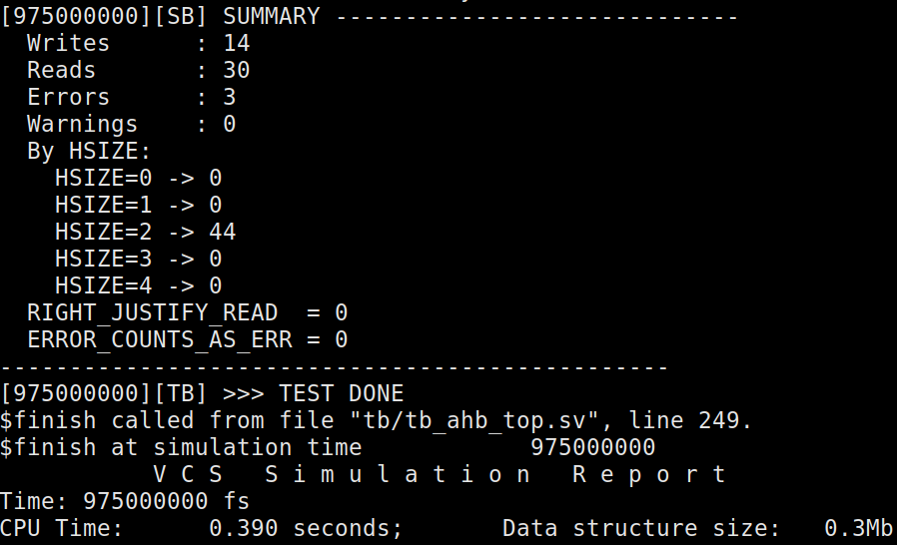
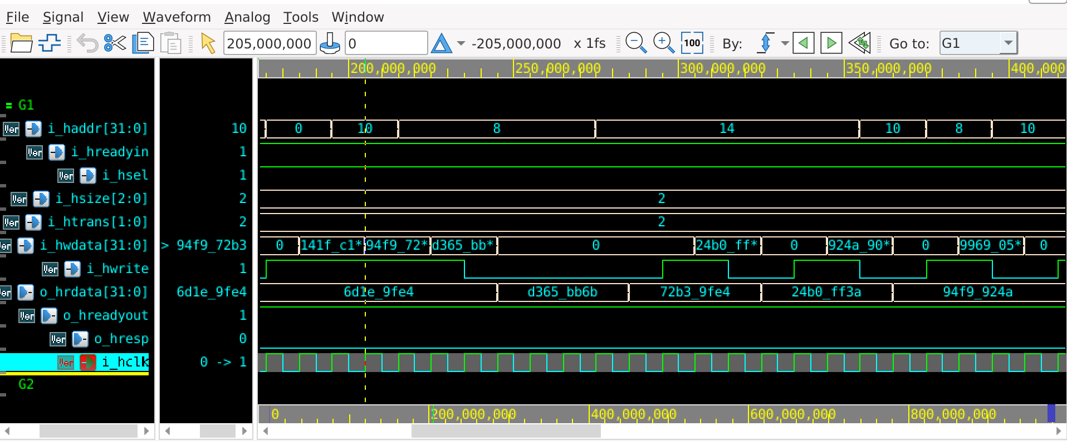
4. Verification results

Slide 57
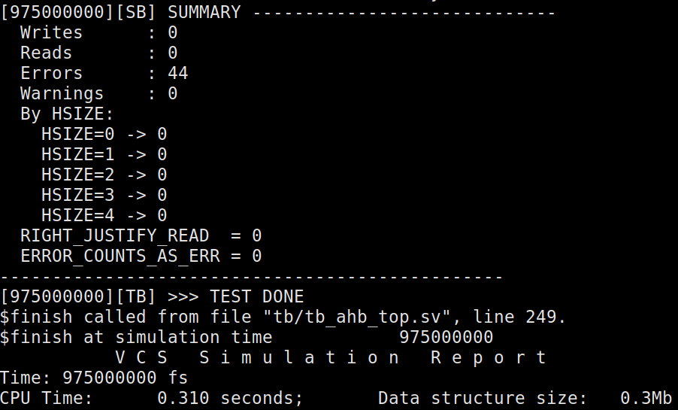
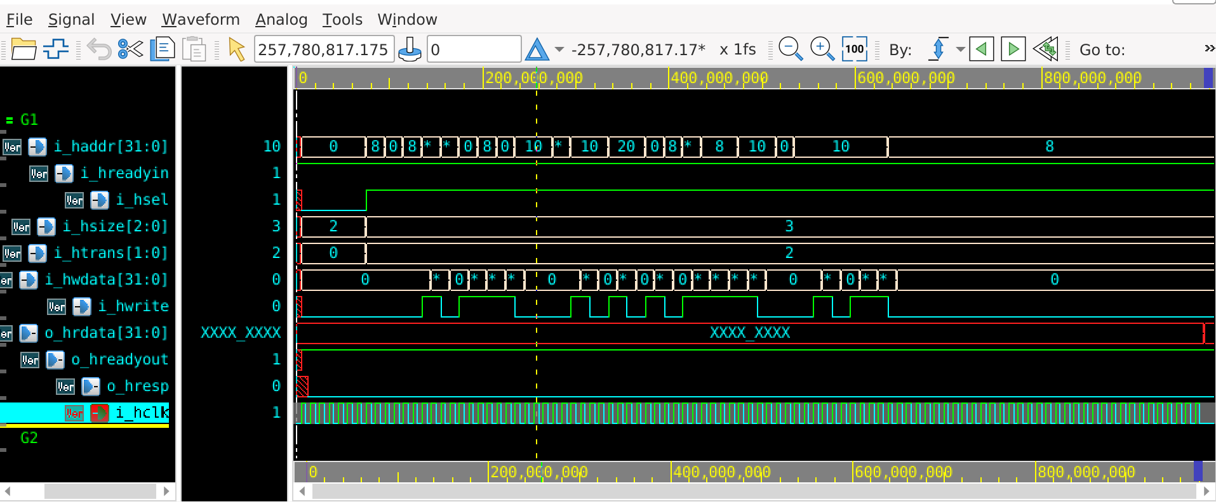
4. Verification results

Slide 58
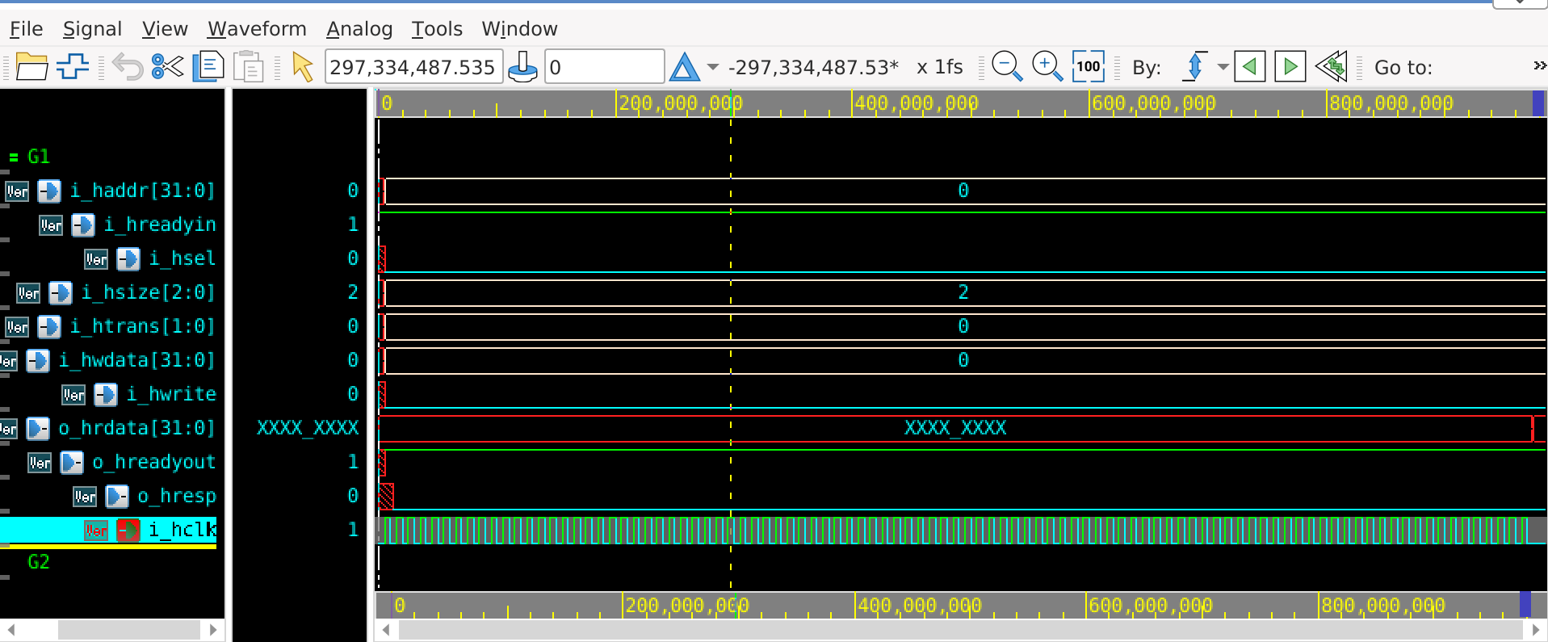
4. Verification results

Slide 59
4. Verification results
Index | Feature | Descriptions
1 | Adjacent address region (0x04 and 0x00 or 0x10 or 0x14) | Issue: Writes to 0x00 and 0x04 with different values are not preserved independently. Observed Behavior: Reading from 0x04 returns the lower 4 bytes of the value previously written to 0x00. Expected Behavior: The value read from 0x04 should match the value written to 0x04, unaffected by the write to 0x00.
2 | HRESP is not set to 1 (ERROR) | Issue: Invalid transfer size handling.Setup: HSIZE = DWORD (64-bit) on a 32-bit data bus. Observed Behavior: o_hresp remains deasserted (0). Expected Behavior: The transfer is invalid and must return an ERROR response; thus, o_hresp should be asserted (1) on the completion cycle.

Slide 60
Thanks for watching
Digital VLSI Design
Actor: Hoang Bao Long

